Slide 1
Project Topic
AI-Driven Mental Health Companion
Presented By
Pratik Deepak Bandpatte [24129]
Neha Raju Medar [24147]
Devesh Narendra Mahajan [24135]
Vishal Ajay Wagh [24126]
Under the Guidance of
Mrs. Mayuri Fegade

Slide 2
Outline
Problem Statement/Title
Abstract
Introduction
Literature Survey (Comparison With Existing System)
Methodology
Design/Algorithms/Techniques Used
Modules Split-up
Proposed System
Software Tools/Technologies To Be Used
Working Module

Slide 3
Problem Statement
Despite increasing awareness of mental health issues, many people encounter barriers to accessing timely and personalized support due to limitations in traditional services. This project aims to address these challenges by developing an AI-powered mental health companion that uses advanced natural language processing to offer real-time and empathetic support, thereby improving access to mental health support and enhancing overall well-being.

Slide 4
Abstract
In today's fast-paced world, mental health challenges are increasingly prevalent, yet access to timely support remains a critical issue.
This presentation introduces an innovative AI-Driven Mental Health Companion designed to provide accessible, personalized, and on-demand mental health support.
Utilizing advanced natural language processing and machine learning algorithms, the companion engages users in real-time conversations, offering coping strategies, mood tracking, and resource recommendations tailored to individual needs.
Department of Artificial Intelligence and Data Science

Slide 5
Introduction
In today’s fast-paced world, mental health challenges have become increasingly prevalent, affecting millions globally. Addressing these challenges requires innovative solutions that are accessible, scalable, and effective.
The "AI-Driven Mental Health Companion" project aims to leverage advancements in Artificial Intelligence (AI) and Machine Learning (ML) to create a virtual assistant that supports mental well-being.
This AI-powered companion will utilize Natural Language Processing (NLP) and Generative AI to interact with users, provide emotional support, and offer actionable insights based on real-time sentiment analysis.

Slide 6
Aim And Motivation
Aim:
To develop an AI Mental Health Companion that provides continuous support for students by tracking well-being, offering personalized suggestions, and connecting them to professional resources.
Motivation:
Driven by the growing need for accessible mental health resources, this project aims to leverage AI to provide continuous, personalized support that overcomes barriers like cost, availability, and stigma.

Slide 7
Scope
The scope of this project is to create an AI-driven mental health companion designed to offer personalized emotional support and relevant resources to users.
By utilizing advanced NLP techniques, the project aims to enhance user interaction through accurate and empathetic responses.
The initiative focuses on improving accessibility to mental health resources and providing guidance, without substituting professional mental health services.

Slide 8
Literature Survey(Comparison of Existing System with Propose System)
Existing System | Propose System
An AI-driven chatbot aimed at enhancing mental wellness through self-help techniques and user interaction. An AI-driven chatbot aimed at enhancing mental wellness through self-help techniques and user interaction. | An advanced AI-driven mental health companion that integrates various therapeutic approaches, including CBT, mindfulness, and psychoeducation, to support users holistically. A text-based chatbot designed to deliver mental health support, specifically leveraging cognitive behavioral therapy (CBT) principles.
Highly customizable experience, allowing users to define their avatar and conversation topics, which enhances engagement but may dilute therapeutic focus. | Features advanced adaptive learning that continuously tailors interactions based on user history, preferences, emotional states, and behavioral patterns, ensuring a highly personalized experience.
Implements basic sentiment analysis that can detect general mood changes but may struggle with specific emotional contexts and subtleties in user language. | Utilizes advanced natural language processing (NLP) and emotion detection algorithms that provide nuanced understanding of user emotions, enhancing responsiveness and appropriateness of support.
Designed for general users seeking mental health support, appealing to a wide demographic, including those experiencing mild to moderate distress. | Aims to provide comprehensive mental health support to a diverse audience, addressing a wide range of needs, including those experiencing anxiety, depression, and other mental health challenges, ensuring inclusivity and accessibility.

Slide 9
Literature Review
Sr. No. | Paper Details | Problem Discussion | Algorithm /Technique used | Parameter Consider | Result
1 | KrishnaVani :-An AI-Powered Companion | The paper highlights increasing mental health issues among students aged 18 to 24, including depression and suicidal thoughts. It introduces KrishnaVani, an AI companion offering confidential emotional support and practical advice. | Rasa Framework, TensorFlow, Natural Language Understanding (NLU), Advanced NLP Techniques | Accuracy and Relevance, User Satisfaction, Comprehensive Scope, Natural Language Understanding (NLU), User Customization and Personalization | KrishnaVani excels with 92% accuracy and 87% user satisfaction, surpassing competitors in addressing a range of student mental health issues. It receives high praise for its intuitive design and empathetic responses.
2 | Chatbot for Mental Well-being | The project aims to create a 24/7 generative chatbot for emotional expression and stress relief, enabling users to track their mood over time. | It employs an SVM classifier for mood detection and a Seq2Seq model with RNNs for generating responses based on tokenized input. | The system uses user mood from the SVM classifier and tokenized input vectors, with an attention mechanism to improve response generation. | The Seq2Seq model achieved 96.53% accuracy and 90.69% validation accuracy after 30 epochs, providing a user-friendly interface for mood classification and response generation.
Department of Artificial Intelligence and Data Science

Slide 10
Sr. No. | Paper Details | Problem Discussion | Algorithm /Technique used | Parameter Consider | Result
3 | Artificial Intelligence-based Chatbot For Mental Health | Depression affects 264 million people globally, with high stress and anxiety in those aged 15-29, often leading to unresolved mental health issues.. | The AI chatbot uses machine learning and NLP, including sentiment analysis and entity recognition, to interact with users and provide advice. | It evaluates users' mental health through targeted questions to tailor responses to their needs. | Chatbots like Woebot, Wysa, and Joy show promise in offering emotional support and resources, improving access to mental health care.
4 | A Mental Health and Well-Being Chatbot: User Event Log Analysis | The study analyzes user interactions with a chatbot designed for mental health support, focusing on understanding user engagement patterns and retention over time. It identifies different user types based on their interaction frequency and duration of use. | The k-means clustering algorithm was employed to categorize users into distinct groups based on their behavioral usage of the chatbot. Principal component analysis was also utilized to visualize the clustering results and reduce the dimensionality of the data. | Key parameters for clustering included the number of unique days users accessed the chatbot, tenure (the duration from first to last use), mood logs completed, conversations accessed, and total interactions with the chatbot. | The analysis identified three user clusters: "abandoning users" (81.7%), "frequent transient users" (2.2%), and "sporadic users" (16.1%), with abandoning users displaying the lowest engagement.
Department of Artificial Intelligence and Data Science

Slide 11
Methodology
Literature Review and Requirements Analysis:
Review existing mental health tools and AI applications, and conduct surveys and interviews to understand user needs and preferences.
System Design:
Develop a high-level architecture for the AI-driven companion, including components for NLP, sentiment analysis, and user interaction, along with UML diagrams to model system functionalities and interactions.
Development:
Implement NLP and sentiment analysis algorithms, integrate generative models for engaging responses, and create a user-friendly interface with a robust backend for real-time interactions.
Department of Artificial Intelligence and Data Science

Slide 12
System Architecture Planning
Components:
Data collection
Data processing
Data analysis
Machine Learning
Recommendation modules.

Slide 13

System Architecture
Chatbot Frontent
Resource Portal Backend
Conversation stories and rules
Conversation examples
Response generation rules
Search engine
Intend Recognition and Entity Extraction
Rest API
resource database
System Architecture of AI driven Mental Health Companion

Slide 14
Proposed Module Names
User Management Module
Chat Interface Module
AI Engine Module
Mental Health Resources Module
Analytics and Insights Module
Data Management Module
Notifications Module
Ethics and Privacy Module
API Integration Module
Admin Dashboard Module
Department of Artificial Intelligence and Data Science

Slide 15
Algorithms
1. NLP Algorithm:
Support Vector Machines (SVM)
BERT
LSTM
GPT
2. Machine Learning Algorithms:
Q-Learning
Recommendation Algorithms
Content-Based Filtering
TF-IDF
3. Behavioral and Predictive Analytics Algorithms:
Convolutional Neural Networks (CNNs)
Recurrent Neural Networks (RNNs)
Transformer Models
4. Data Privacy and Security Algorithms:
AES (Advanced Encryption Standard)
RSA (Rivest–Shamir–Adleman)
Differential Privacy
Department of Artificial Intelligence and Data Science

Slide 16
Modules Split-up
1. User Interface (UI) Module
Chat Interface
Mood Tracking Dashboard
Resource Access
2. Natural Language Processing Module
Text Analysis Engine
Sentiment Analysis
Intent Recognition
3. Machine Learning (ML) Module
User Behavior Profiling
Personalization Algorithms
Continuous Learning Feedback Loop
4. Data Management Module
Secure User Data Storage
Data Privacy & Security Controls
Analytics and Reporting Tools
5. Support and Resources Module
Coping Strategies Database
Community Support Links
Department of Artificial Intelligence and Data Science

Slide 17
Modules Split-up
User interface
(UI)
Natural Language Processing
(NLP)
Machine Learning
(ML)
Support and Resource
Module
Data Management
Module

Slide 18
Risk Identification
1. Risk Identification
Developing an AI-Driven Mental Health Companion involves managing risks related to data handling, system reliability, and user acceptance due to the sensitivity of mental health data, real-time assessments, and continuous interaction.
2. Risk Analysis
Data Privacy & Security: High impact, as mishandling of sensitive user data could lead to breaches of confidentiality, violating ethical standards and trust.
AI Misinterpretation of Emotions: High impact, as incorrect emotional assessments might lead to inappropriate or ineffective mental health interventions.
Model Bias: Medium impact, as inherent biases in training data may result in inaccurate emotional analysis, especially for underrepresented groups.
User Resistance: Medium impact, as users may be hesitant to engage with AI-driven mental health tools due to stigma or lack of trust.

Slide 19
3. Risk Mitigation
Data Encryption & Anonymization: Implement encryption and data anonymization techniques to secure sensitive user information. Strict adherence to regulatory requirements (e.g., GDPR) to ensure data privacy.
AI Model Validation: Use continuous validation and retraining of AI models with diverse datasets to reduce biases and improve accuracy in emotional assessments.
User Training & Support: Provide comprehensive user training and develop user-friendly interfaces to promote engagement and reduce resistance. Offer transparency on how AI processes information.
Ethical Framework & Compliance: Regularly review legal and ethical frameworks to ensure compliance with health data regulations and ethical AI use.

Slide 20
4. Monitoring and Management
Regular Audits and Diagnostics: Implement periodic audits and diagnostics to ensure system functionality and the accuracy of emotional assessments.
Ethical Reviews: Perform regular reviews of ethical standards and compliance with legal requirements for handling sensitive health data.
Feedback Loops: Establish a robust feedback system where users can report issues and experiences to help improve the AI model over time.
Contingency Planning: Develop alternative strategies and fallback mechanisms in the event of a system failure or ethical concerns, such as escalation to human mental health professionals.

Slide 21
Software Tools/Technologies to be used
1. Software Requirements:
Windows/Ubuntu OS
Python3 and suitable IDE
Flask/ Django, Required Libraries
3. Database Requirements:
MySQL/ MongoDB
2. Hardware Requirements:
i5 Processor
256 SSD/1TB HDD
8GB RAM
GPU 4GB VRAM with CUDA support.
Department of Artificial Intelligence and Data Science

Slide 22
Working Model
User interface
[Web Interface]
[Voice Assistant]
User Input
[Mood Tracking]
[Journaling]
[Conversation Inputs]
Data Processing
[Collect Data]
[User Inputs]
[Interaction History]
Personalization Engine
[Adaptive Learning]
[Feedback Loop]
[Behaviour Analytics]
Future Enhancements
[Community Support Features]
User Engagement
[Interactive Activities]
[Regular Check-ins]
Security Measures
[Data Privacy]
[Encryption]
Support Features
[Therapeutic Techniques]
[Mindfulness Practices]
Department of Artificial Intelligence and Data Science

Slide 23
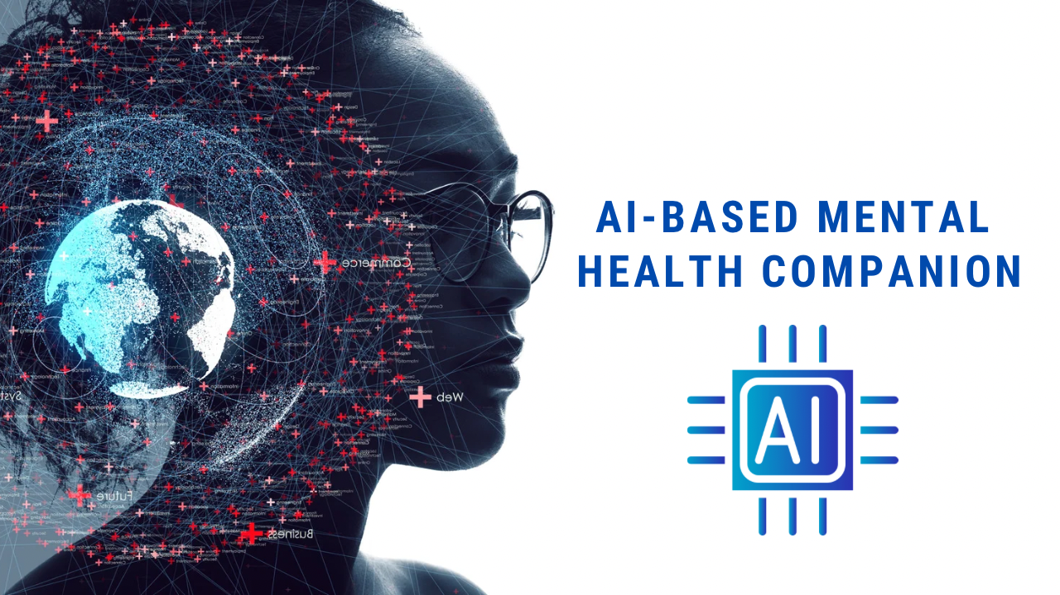
Thank You..!

